Slide 1
SET Operators

Slide 2
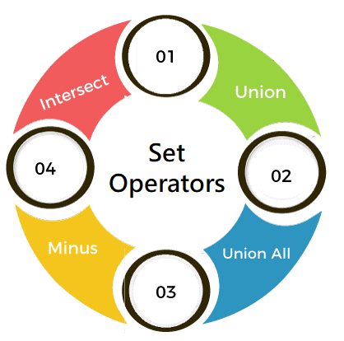
SET Operators
SET operators are special type of operators which are used to combine the result of two queries.
Operators covered under SET operators are:
UNION
UNION ALL
INTERSECT
MINUS

Slide 3
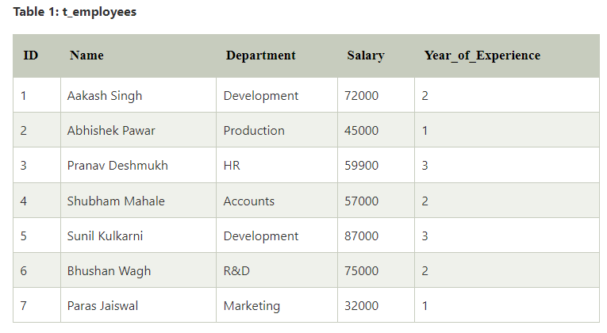

Slide 4
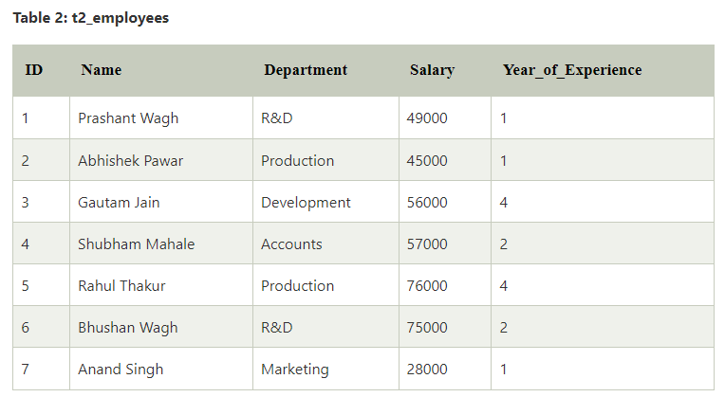

Slide 5
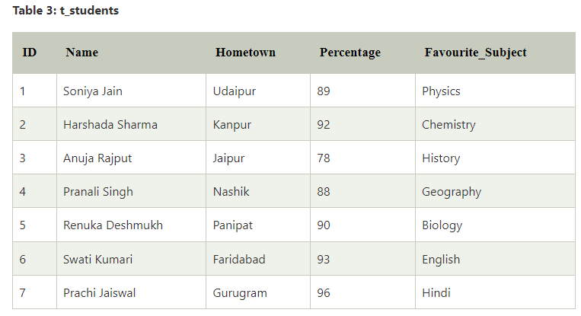

Slide 6
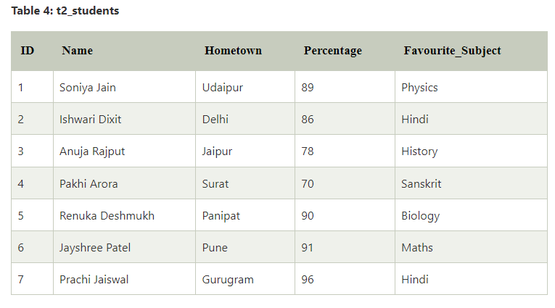

Slide 7
SET Operators
1. UNION
UNION will be used to combine the result of two select statements.
Duplicate rows will be eliminated from the results obtained after performing the UNION operation.
Example 1:
Write a query to perform union between the table t_employees and the table t2_employees

Slide 8
SET Operators
UNION
SELECT *FROM t_employees UNION SELECT *FROM t2_employees;

Slide 9
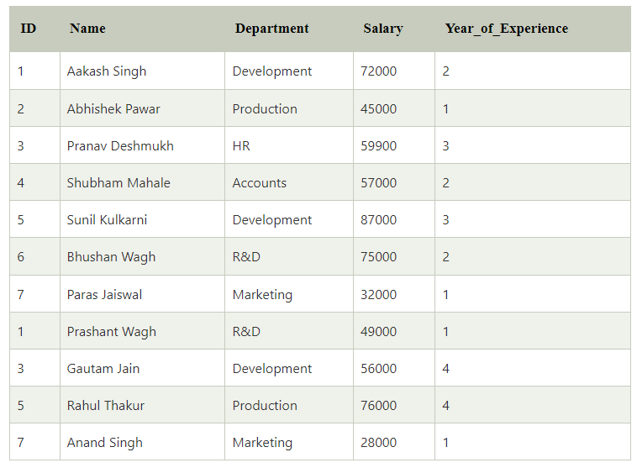
SET Operators
UNION

Slide 10
SET Operators
UNION
Example 2:
Write a query to find the student details from both table t_students and the table t2_students.

Slide 11
SET Operators
UNION
SELECT *FROM t_students UNION SELECT *FROM t2_students;

Slide 12
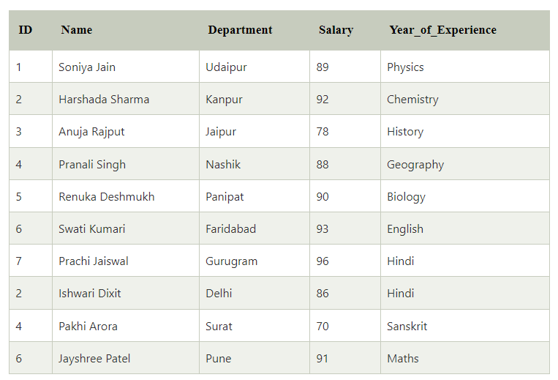
SET Operators
UNION

Slide 13
SET Operators
2. UNION ALL
Includes Duplicates:
The UNION ALL operator includes all rows from the combined result set, including duplicates.
This means that if a row appears in more than one of the SELECT queries, it will appear as many times as it occurs.
SELECT *FROM t_students UNION ALL SELECT *FROM t2_students;

Slide 14
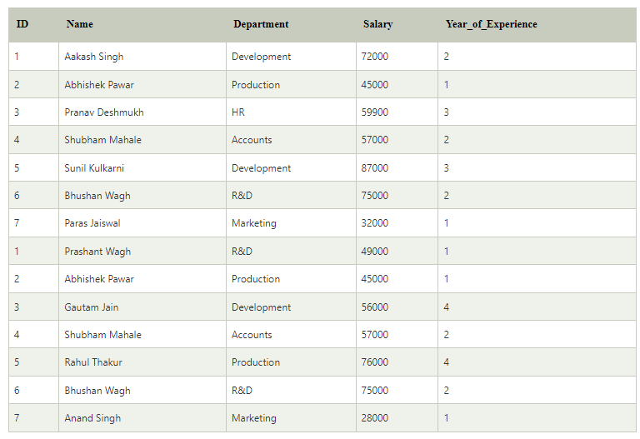
SET Operators
2. UNION ALL

Slide 15
SET Operators
3. INTERSECT
It is used to combine two SELECT statements, but it only returns the records which are common from both SELECT statements.
Example 1:
Write a query to perform intersect operation between the table t_employees and the table t2_employees.

Slide 16
SET Operators
3. INTERSECT
SELECT *FROM t_employees INTERSECT SELECT *FROM t2_employees;

Slide 17
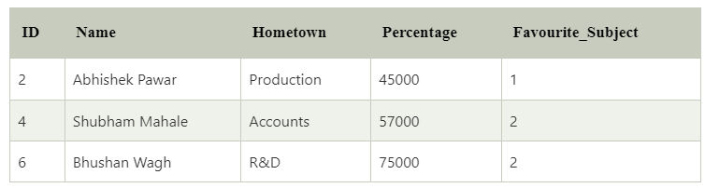
SET Operators
3. INTERSECT

Slide 18
SET Operators
3. INTERSECT
Example 2:
Write a query to perform intersect operation between the table t_students and the table t2_students.

Slide 19
SET Operators
3. INTERSECT
SELECT *FROM t_students INTERSECT SELECT *FROM t2_students;

Slide 20
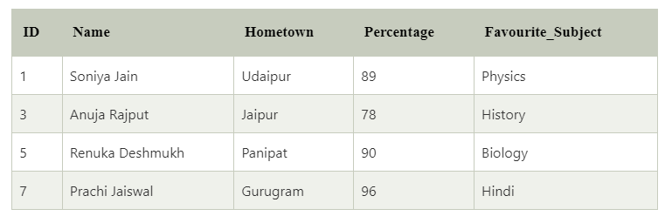
SET Operators
3. INTERSECT

Slide 21
SET Operators
4. MINUS
It displays the rows which are present in the first query but absent in the second query with no duplicates.
Example 1:
Write a query to perform a minus operation between the table t_employees and the table t2_employees.
List the details of the employees who are present in t_employees but not in t2_employees

Slide 22
SET Operators
4. MINUS
SELECT *FROM t_employees MINUS SELECT *FROM t2_employees;

Slide 23
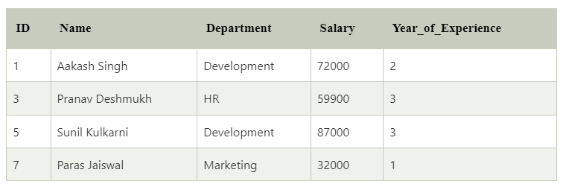
SET Operators
4. MINUS

Slide 24
SET Operators
4. MINUS
SELECT *FROM t_students MINUS SELECT *FROM t2_students;

Slide 25
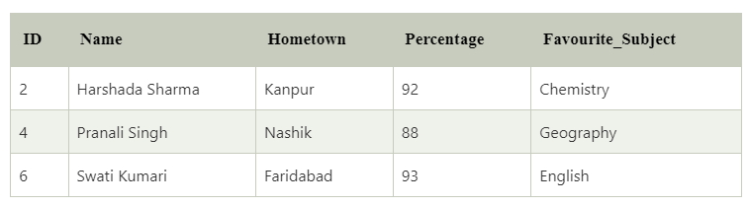
SET Operators
4. MINUS

